Slide 1

Federation Project
Summary of Materials (WP 3.1 )

Slide 2
Summary of Contents
► Materials Sciences
► Physics
◆ Element Detection in Muon Spectroscopy
◆ Predicting Beam Profile in Synchrotron Beam
◆ Inelastic Neutron Scattering Classification
◆ Generating Graphene EM Images (GANs)
◆ Generating Graphene EM Images (VAEs)
◆ Band Gap Regression
◆ Phase Classification Magnetic Materials
◆ Denoising EM Data
◆ Classifying Gravitational Waves
◆ Predicting Masses in Gravitational Waves
◆ Particle Segmentation
◆ Detailed Particle Type Classification
► Healthcare
► Astronomy/Cosmology
◆ Equilibrium State Prediction
◆ Finding Salient Features in Chemicals
◆ Denoising Power Density Spectrums
◆ Uncertainty Estimation in Radiative Models
◆ Continuum Image Classification in SKA
◆ Galaxy Classification (CNN)
◆ Galaxy Classification (DNN)
◆ Galaxy Image Generation
► Fusion
◆ Plasma Clustering
◆ Plasma Regression
◆ 2D Wave Equations using PINNs

Slide 3
Materials Science

Slide 4
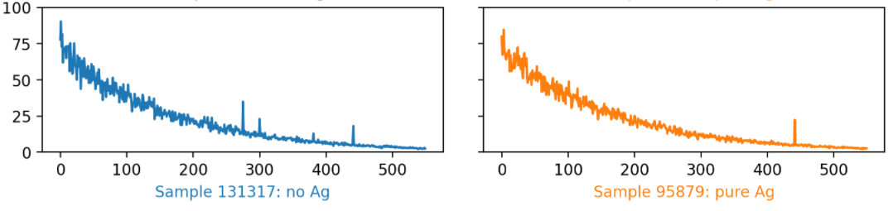
Element Detection in Muon Spectroscopy
Muon spin spectroscopy is an atomic, molecular and condensed matter experimental technique that exploits nuclear detection methods
The data in this example is generated from simulated muon spectroscopy experiments, but realistic enough to have multiple elements
We train a neural network to detect the presence of Ag in samples

Slide 5
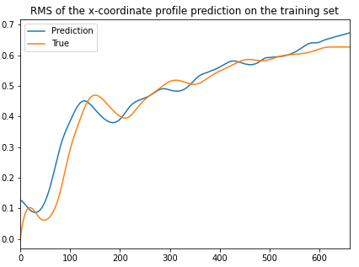
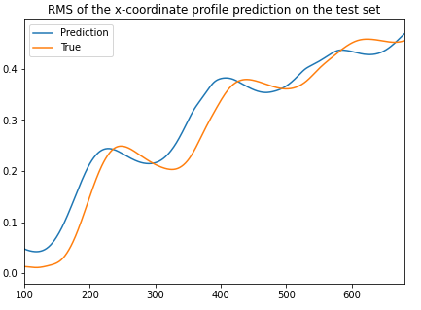
Predicting Beam Profile in Synchrotron Beam
Establishing correct beam profiles, particularly within injectors of synchrotron, is an important aspect of maintaining high quality beams (neutrons/x-rays/lasers)
Usually, X-Y positions are used to assess this with RMS current
Here, we focus on neutron beams
Usually these are obtained using very expensive simulation techniques
Here, we use an LSTM to perform this, viewing them as surrogates

Slide 6
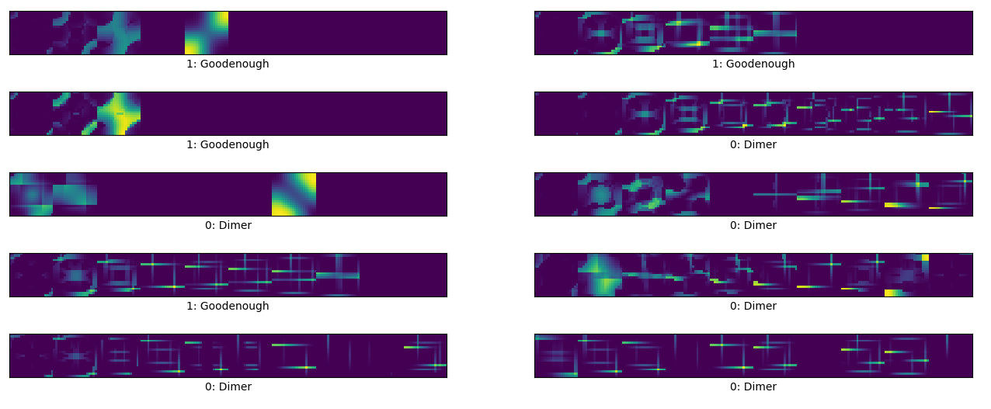
Inelastic Neutron Scattering Classification
Inelastic neutron scattering (INS) can be used to distinguish between two possible magnetic Hamiltonians of the system
For this example, we have simulated datasets for each of the possible Hamiltonians
We use a CNN to perform this classification (two classes: Dimmer or Good Enough)

Slide 7
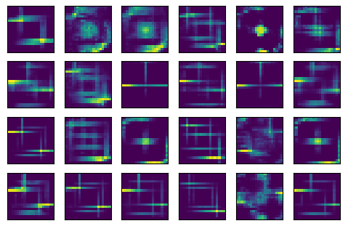
Generating Graphene EM Images (GANs)
Inelastic neutron scattering (INS) can be used to infer information about the forces present in a material
Neutrons scatter off a sample, exchanging energy with certain fundamental vibrational modes of the sample
These vibrational modes include phonons (interatomic boding forces) and magnons (spin coupling between magnetic nuclei)
We generate more diverse data that are plausibly drawn from the training dataset using Generative Adversarial Networks (GANs)
Generated images
Samples in the training set

Slide 8
Generating Graphene EM Images (VAEs)
Inelastic neutron scattering (INS) can be used to infer information about the forces present in a material
Neutrons scatter off a sample, exchanging energy with certain fundamental vibrational modes of the sample
These vibrational modes include phonons (interatomic boding forces) and magnons (spin coupling between magnetic nuclei)
We generate more diverse data that are plausibly drawn from the training dataset using Variational Autoencoders (VAEs)
Generated images
Samples in the training set

Slide 9
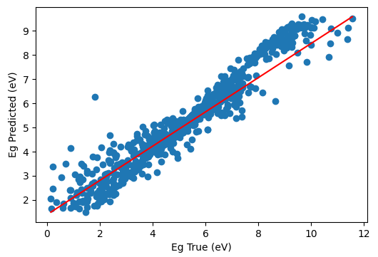
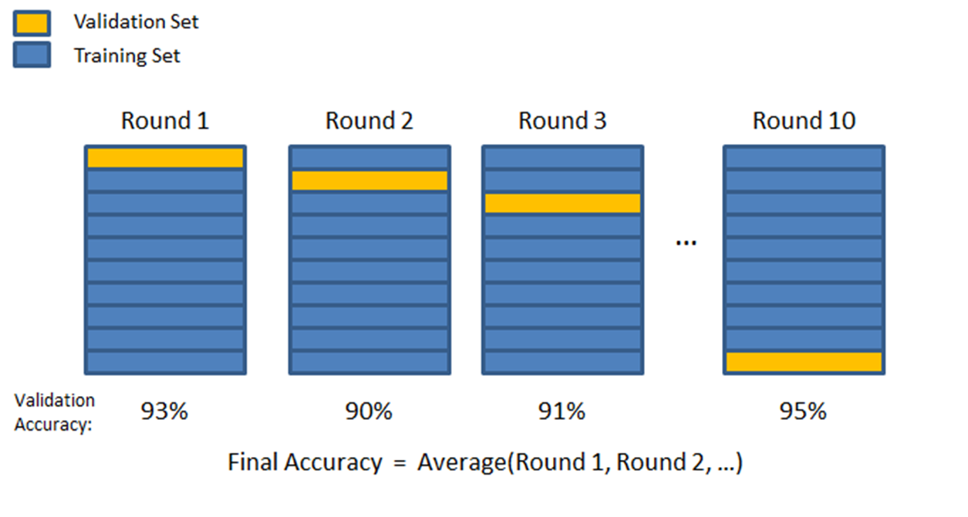
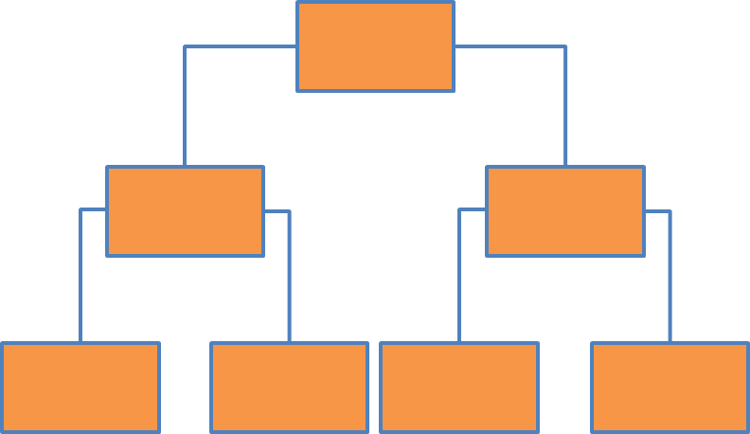
Band Gap Regression
Determining the band gap of a material from its composition is basic aspect of materials research
These are usually done using rather expensive quantum mechanical calculations
Here, we use decision trees for this purpose
Loss
Number of trees

Slide 10
Astronomy / Cosmology

Slide 11
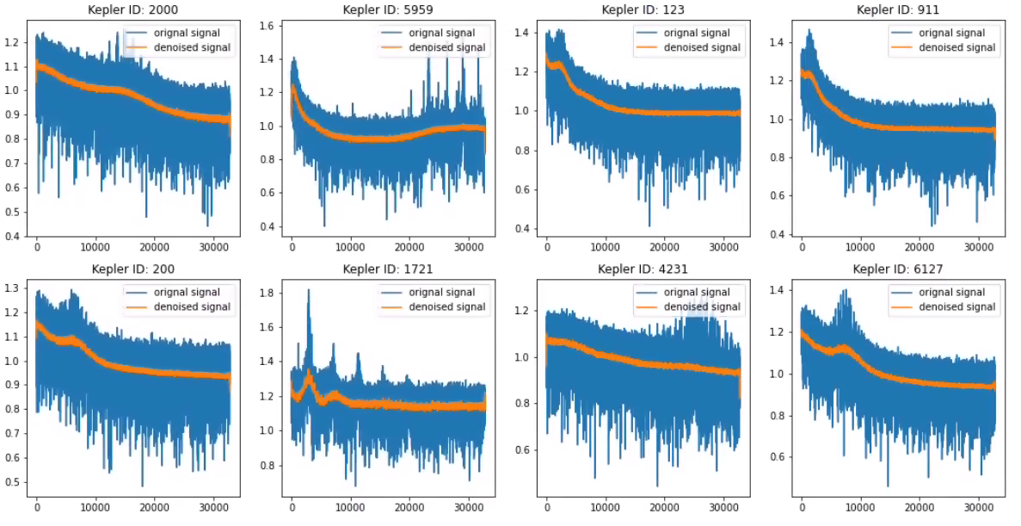
Denoising Power Density Spectrums
Identification of exo-planets and exo-planet hosting stars are fundamental to astronomy
Missions like Kepler gather various forms of data around stars in our universe (objects)
Understanding their power density spectrum is key to locating interesting objects (exo-planet hosting stars) from their oscillations of spectrums and their maximal power
However, these spectrums are often polluted with noise, making this process very hard
Very deep convolutional autoencoder to remove noise in power density spectrums
Examples of original signals and their denoised counterparts

Slide 12
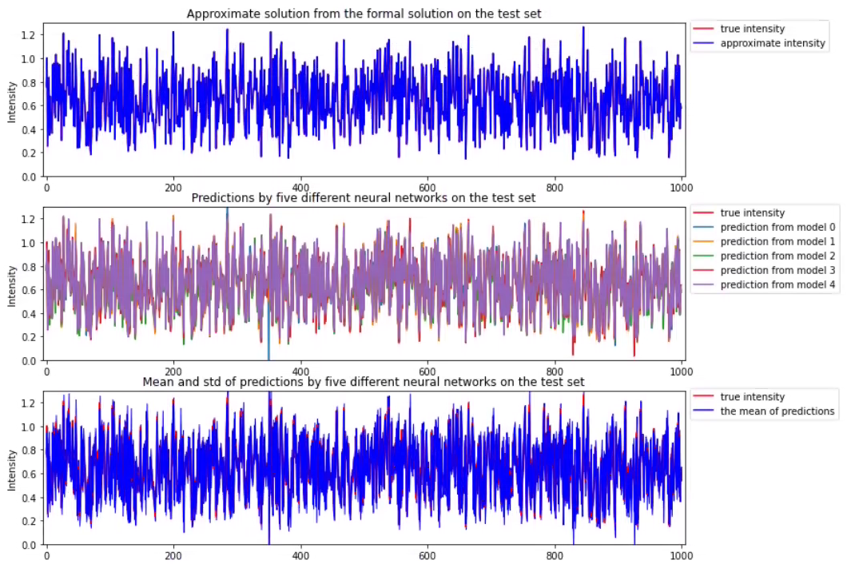
Uncertainty Estimation in Radiative Models
Radiative transfer model quantifies how the intensity changes along a ray
The model can be solved given boundary conditions at the inception of each ray
The aim of this work is to find a neural network to emulate the model, and to estimate uncertainty of intensity using multiple neural networks
UQ Estimation Using Five Neural Networks

Slide 13
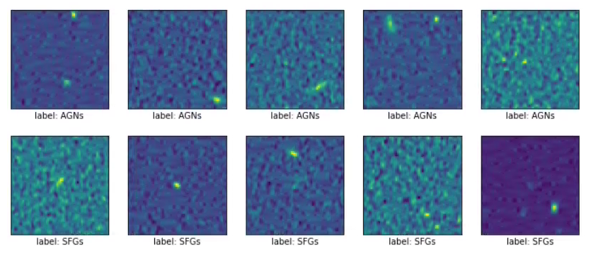
Continuum Image Classification in SKA
Square kilometer Array (SKA) will become operational in 2027
At present, simulational studies help building the infrastructure for SKA
One of the challenges is image classification of SKA data
Here, we use simulated datasets (mimicking 560MHz, mid-band telescope Integration)
We use CNN to label them as active galactic nucleus (AGNs) or star forming galaxies (SFGs).
Examples of AGNs and SFGs.

Slide 14
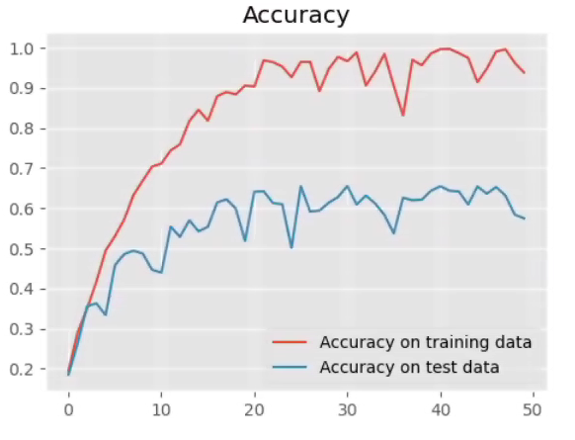
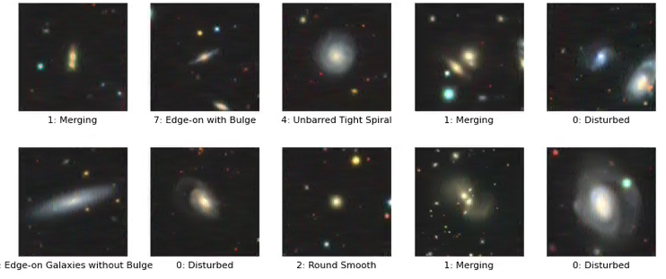
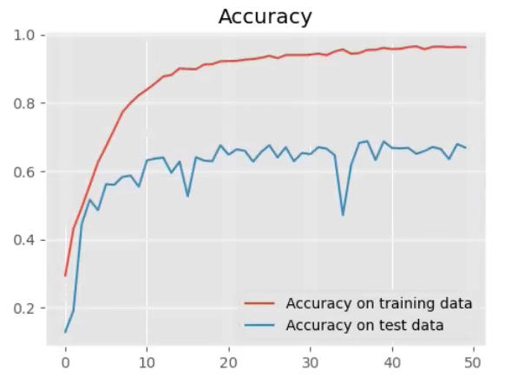
Galaxy Classification (CNN & DNN)
Galaxy classification is a basic building block for astronomy
Possible categories include: 'Disturbed', 'Merging', 'Round Smooth', 'Barred Spiral', 'Unbarred Tight Spiral', 'Unbarred Loose Spiral', 'Edge-on without Bulge', 'Edge-on with Bulge’
We use a CNN and a DNN to perform this classification
More complex cases can be built on this
Accuracy with DNN
Examples of Galaxies
Accuracy with CNN

Slide 15
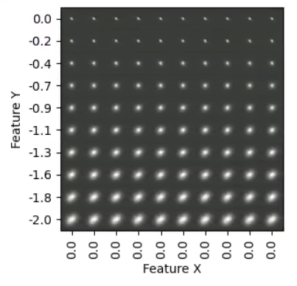
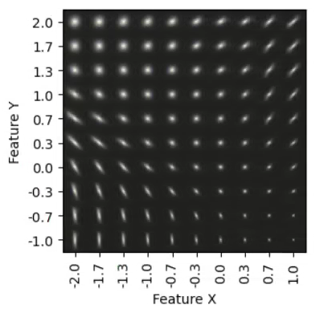
Galaxy Image Generation
Generation of realistic images of galaxies can help various tasks within astronomy
We use a slimmed down version of the Galaxy-10 dataset with five classes: 'Disturbed', 'Merging', 'Round Smooth', 'Barred Spiral', 'Edge-on without Bulge'
We use a Variational Autoencoder (VAE) to generate synthetic images
More complex cases can be built on this
Traversal along with two axes
in the 2D latent space in AE
Traversal along with two axes
in the 2D latent space in VAE

Slide 16
Physics

Slide 17
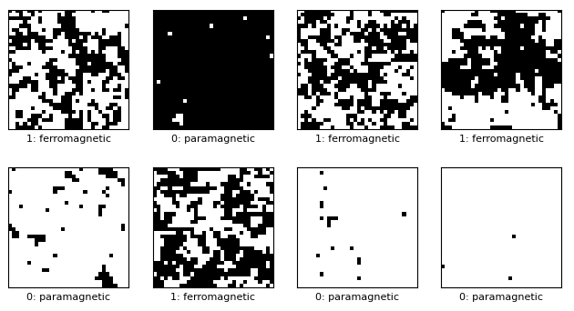
Phase Classification of Magnetic Materials
Ising model
Statistical mechanical model
Useful for magnetic models
Consists of discrete variables to represent magnetic dipole moments (+1 or -1)
Determining the phases (either as ferro or para-magnetic is a critical part of this model
Building a robust Ising model is a challenge with discrete variables
ML Approach
An ML model for these phases of magnetic materials data will be useful to expedite this task if images are used instead of discrete models
This example builds a 2D-CNN model to do this

Slide 18
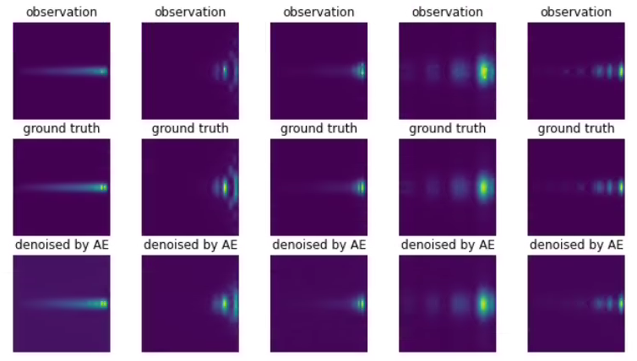
Denoising EM Data
Source of Noise
Surfaces of many particles of surfaces are extremely rough
These imperfectness cause interreference patterns, called speckle, in many imaging modalities
These speckles become integrated part of the images, and becomes noise
Denoising them using conventional techniques require sophisticated models
ML Approach
We model this problem as a reconstruction problem
We use an autoencoder for this purpose and thereby removing the noise

Slide 19
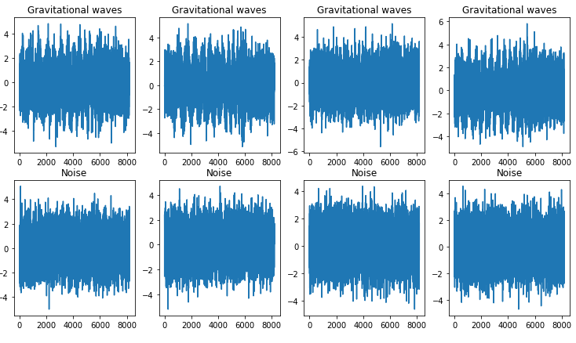
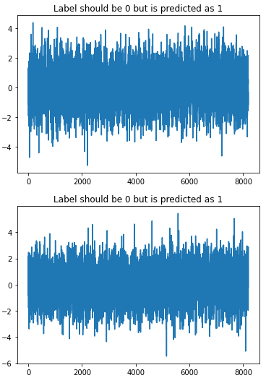
Classifying Gravitational Waves
Examples of Gravitational Waves and Noise
Gravitational waves are disturbances in the curvature of space time, generated by large masses (such as planets / stars)
These are then propagated as waves outward from their source, at the speed of light
Although they ripple, in real scenario most signals are obtained with noise
Hence, they cannot be visually distinguished from noise signals.
We classify these waves and pure noise signals using 1D convolutional and dense layers
Examples of False Negatives

Slide 20
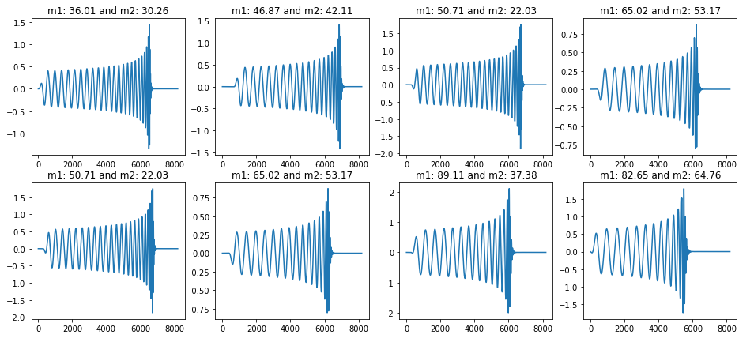
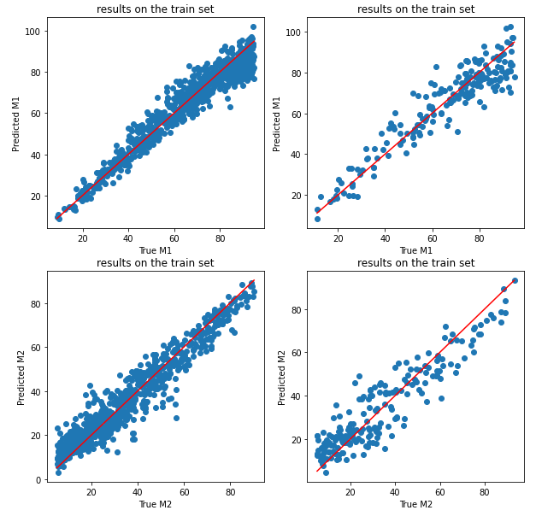
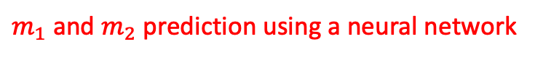
Predicting Masses in Gravitational Waves
Gravitational waves are disturbances in the curvature of space time, generated by large masses (such as planets, stars, etc.)
These are then propagated as waves outward from their source, at the speed of light
Although they ripple, in real scenario most signals are obtained with noise
Predicting the masses caused these GW is a common task
We use neural network here to perform this task
Examples of clean gravitational waves with respect to $m_{1}$ and $m_{2}$
$m_{1}$ and $m_{2}$ prediction using a neural network

Slide 21
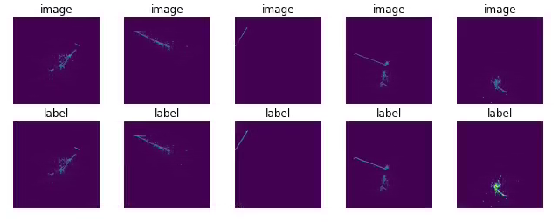
Particle Segmentation
Particle segmentation is the key to identifying each particle type (electron, gamma, muon, charged pion and proton) in bubble chambers
This is often manually performed on an image projected on the XY-planes
Here, we use a U-Net Xception-style model
We classify them into three classes: Background, EM-Shower and Track Particles (non EM-Shower)
Examples of Segmentation

Slide 22
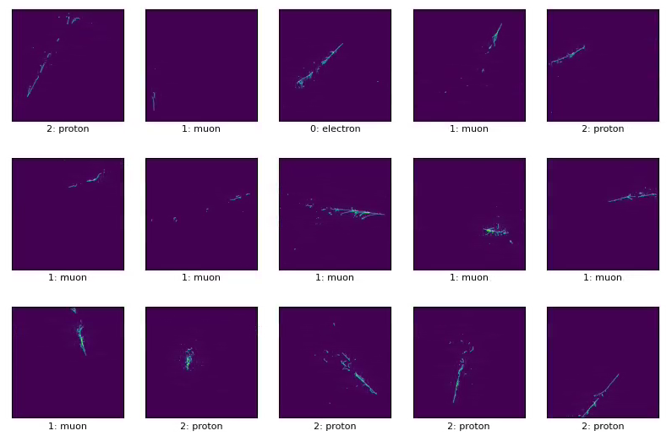
Detailed Particle Type Classification
Particle segmentation is the key to identifying each particle type (electron, gamma, muon, charged pion and proton) in bubble chambers
This is often manually performed on an image projected on the XY-planes.
Here, we use a 2D CNN for this purpose
We classify them into three classes: Electron, Muon and Proton
Examples of Segmentation

Slide 23
Healthcare

Slide 24
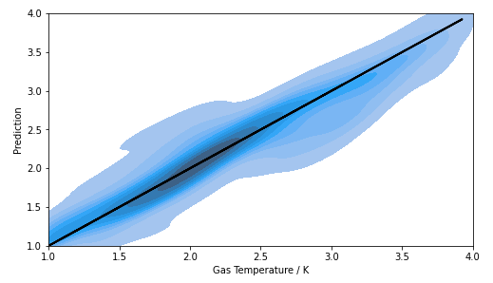
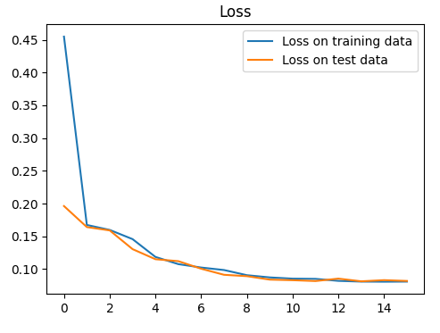
Equilibrium State Prediction
Gas temperature prediction
This is a common task across many domains:
Astrophysics,
Physical chemistry and
Healthcare
Common approach: iterative techniques
This can be expensive
This example expedites this task using deep neural networks
Loss on the training and test

Slide 25
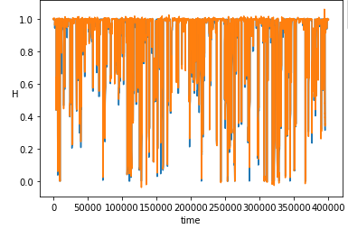
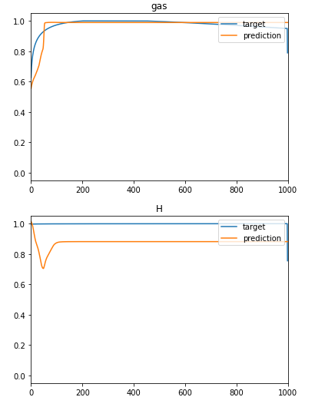
Salient Features of Chemical Abundancies
Abundance Reconstruction
Computing thermochemical properties of gas-like substances is core to many different branches of sciences
This can be computationally intensive
Reducing the features on which these computations can reduce the computational load
This example uses auto-encoders (AE) to identify most salient features
Prediction on Gas and Hydrogen

Slide 26
Fusion

Slide 27
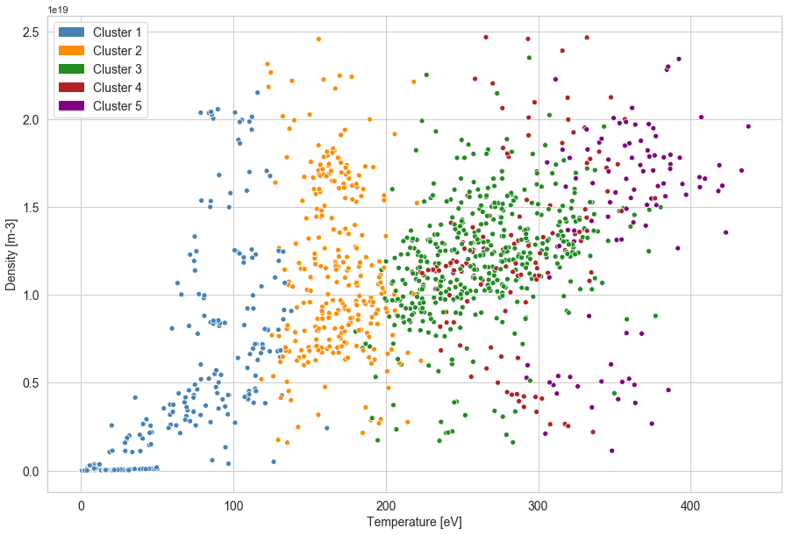
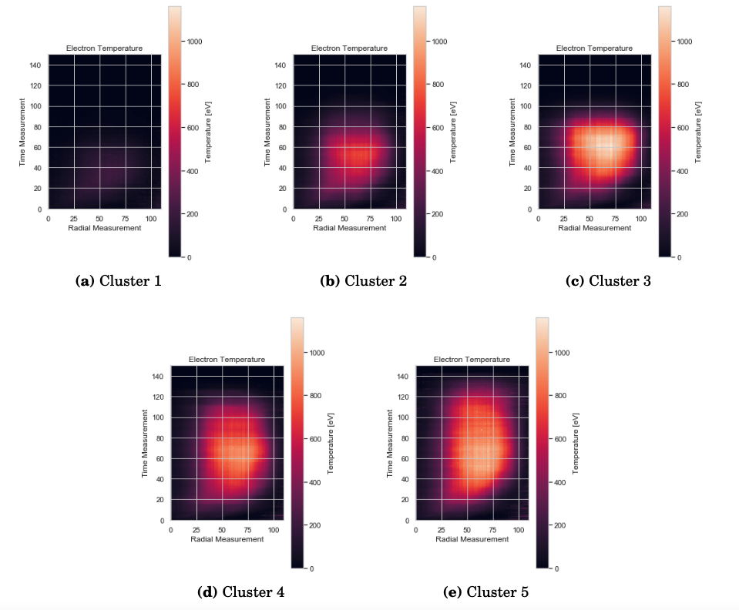
Plasma Clustering
Gas temperature prediction
Thompson scattering in fusion can be different types, based on their temperature and density profiles
Identifying these types is crucial for understanding the fusion reactor designs
This example uses convolutional LSTM to do the clustering
Kymographs: Evolution of Electron Temperatures

Slide 28
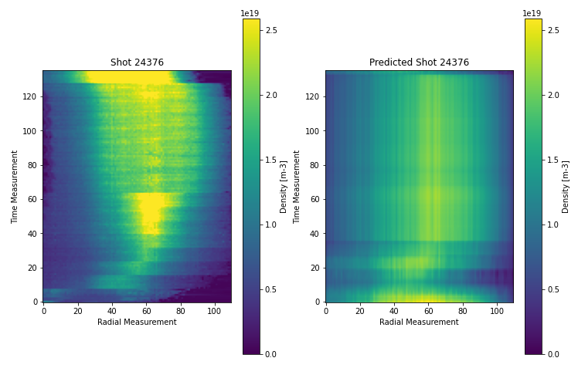
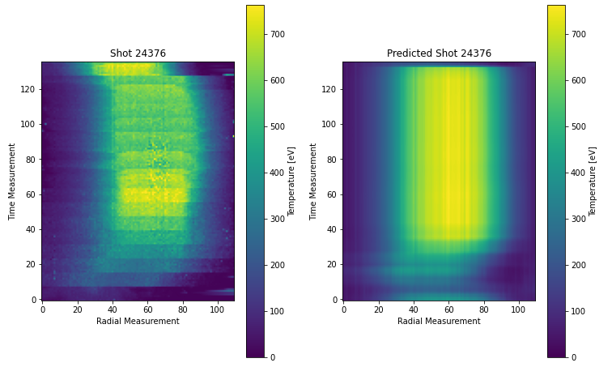
Plasma Regression
Thompson scattering in fusion can be different types based on their temperature and density profiles
Identifying these types are crucial for understanding fusion reactor designs
This example uses convolutional LSTM to do the clustering

Slide 29
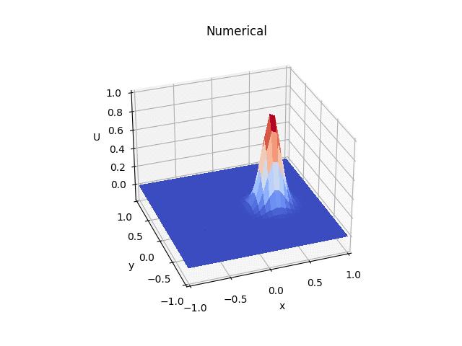

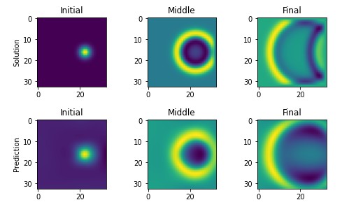
2D Wave Equations using PINNs
2D Wave equations are basic fabric of scattering in fusion can be different types based on their temperature and density profiles
Identifying these types are crucial for understanding fusion reactor designs
Gas temperature prediction
Kymographs: Evolution of Electron Temperatures

